Slide 1
WELCOME TO OUR PROJECT
PRESENTATION
Page No: 01

Slide 2

Our Project Topic
ONLINE SHOPPING
SYSTEM
Page No: 02

Slide 3

VIDYASAGAR UNIVERSITY
SUPERVISED BY:
Mrs. Amita Samanta Adhaya
Lecturer
Department of BCA DTSKSM
Page No: 03

Slide 4
SUBMITTED BY:
Mr. Writtik Bhattacharya
Roll- 46118106 No.-026
Miss. Ayesha Khatun
Roll- 46118106 No.-003
Mr. Debraj Maity
Roll- 46118106 No.-004
Miss. Piyali Das
Roll- 46118106 No.-009
Page No: 04

Slide 5
Presentation Outline
Abstract
Introduction
Background Study
Project Objective
Project Goals
Working Procedure
Testing
Result & Discussion
Limitations
Future Work
Conclusion
Page No: 05

Slide 6
Abstract
Online Shopping is a lifestyle, e-commerce web applications, which provides various electronic and lifestyle products. This project allows viewing various products available enables registered users to purchase desired products instantly using now Cash on Delivery payment system can place an order by using option. This project provides easy access to Administrators and Managers to view orders placed using Pay Later options.
Page No: 06

Slide 7
Introduction
◆ The WEB BASED ONLINE SHOPPING SYSTEM project mainly focuses on basic operations adding new product, new member and updating new information , searching product and members and facility to online shopping. This system has three main modules.
◆ Insertion to database module -user friendly input screen
◆ Extracting from database module-Attractive output screen
◆ Search facility system –search for shopping.
Page No: 07

Slide 8
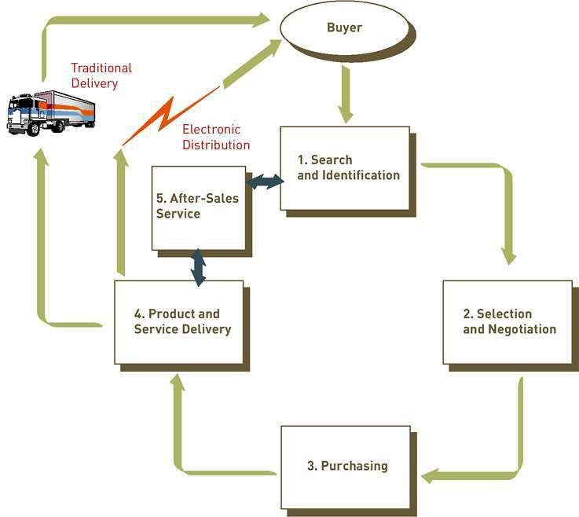
THE PROCESS OF E-COMMERCE Site

Slide 9
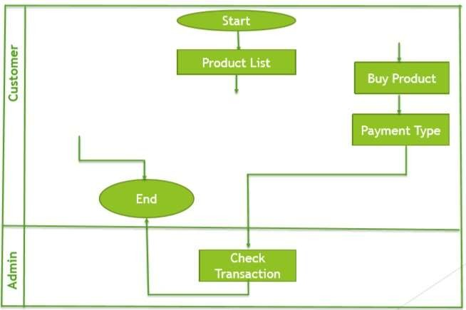
Business process model

Slide 10
Our System
◆ Our System is an e-commerce website from where people can buy products online.
◆ Admin monitors the activity of the users and checks the transactions.

Slide 11
Background Study
In Present System
◆ It is a time consuming process.
◆ It is manual.
◆ It is maintain by several workers.
Page No: 08

Slide 12
Project Objective
The key objective to support the aims are :
◆ The objective of the Shopping systems is to increase the point of customer choice
◆ Reduce time used in shopping
◆ Efficiency in buying product
Page No: 09

Slide 13
Project Goals Some Important Goals
Catch more customer.
Increase the traffic.
Make more sale.
Best customer service.
Minimum Shipping time.
Increase the number of reviews.
Get Positive feedback.
Customer follow up.

Slide 14
Languages & Tools
Necessary
Languages:
VB.NET
HTML 5
CSS 3
JavaScript
jQuery
Bootstrap
PHP
MySQL
Tools:
Adobe Photoshop
Atom

Slide 15
Working Procedure
Requirement for working procedure:
◆ A PC with windows OS.
◆ HTML and CSS for front end design.
◆ PHP and Java for back end operations.
◆ MySQL for database server & SQL for operation.
◆ Atom(text editor) for code writing.
◆ Internet Browser.
Page No: 10

Slide 16
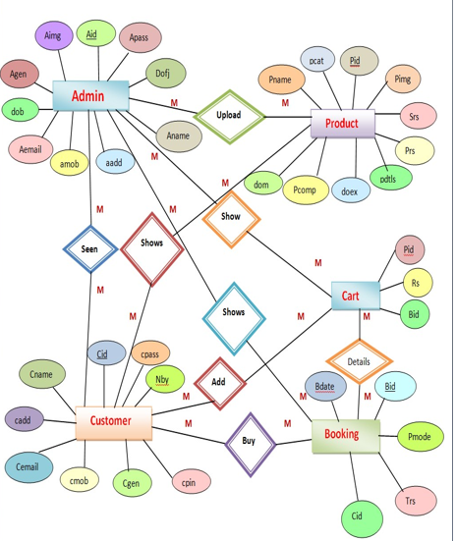
ER-Diagram

Slide 17
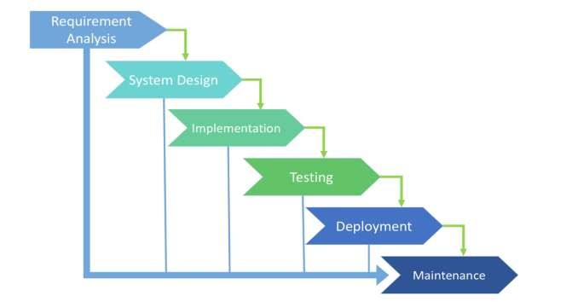
System Development Life Cycle(SDLC):
Fig: Phases of SDLC.
Page No: 11

Slide 18
Design
In this cycle design is very important part. For make a project successful we have to make a full design plan.
Now we show some figure related this project.
Page No: 12

Slide 19
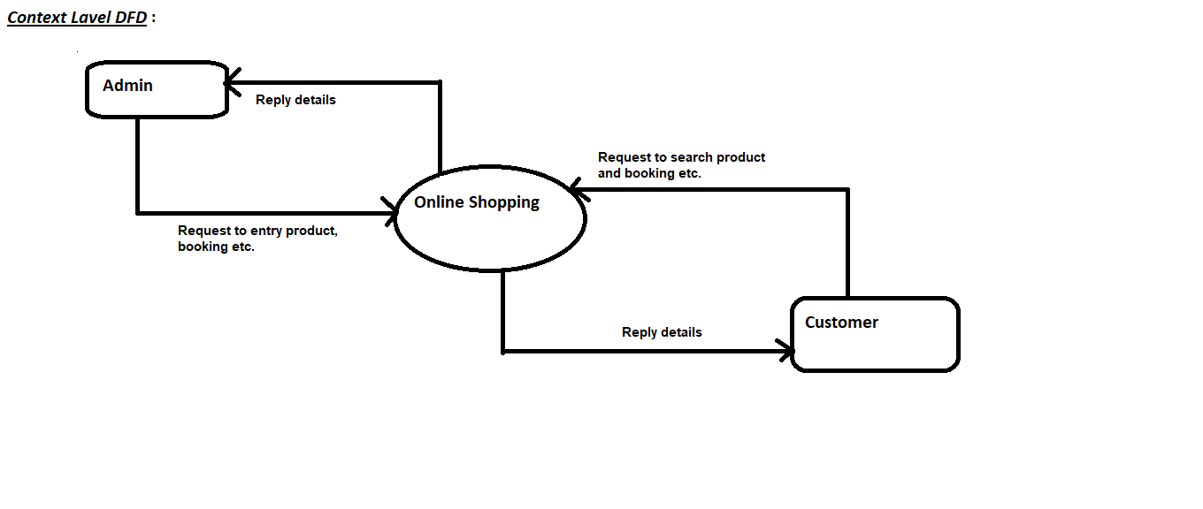
Context Diagram

Slide 20
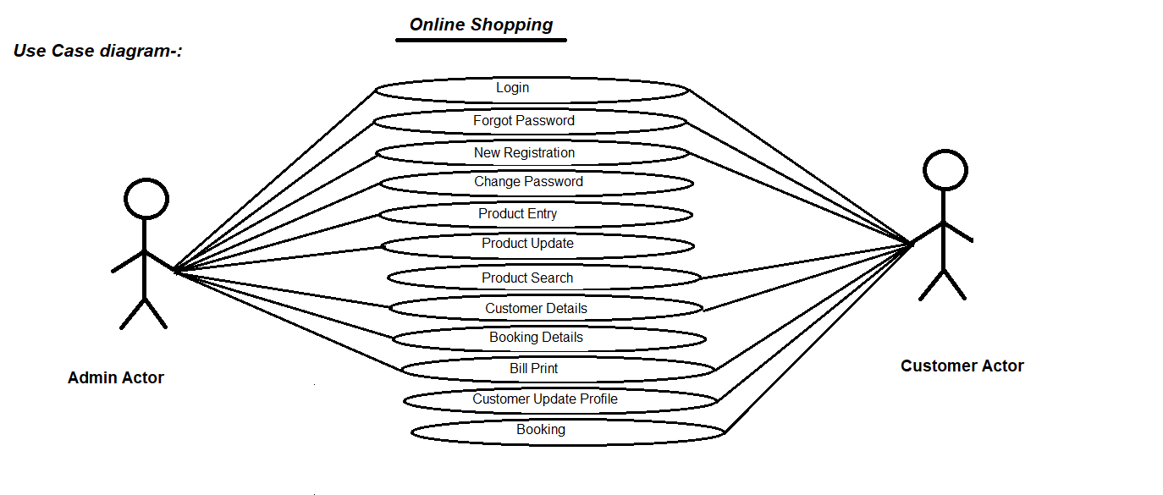
User Case Diagram for Customer and Admin

Slide 21
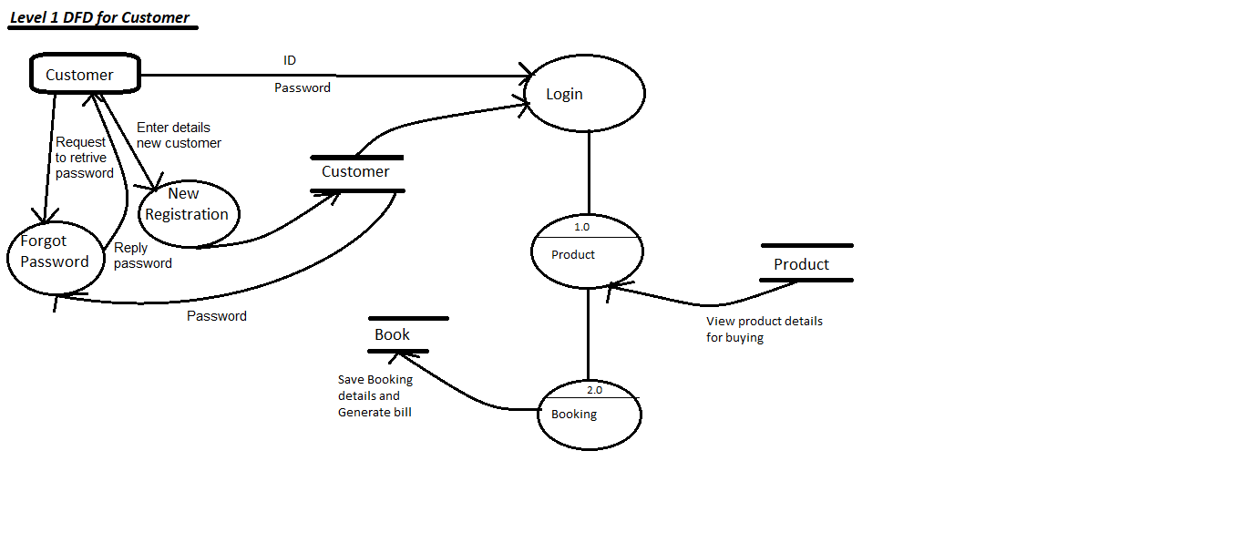
Data Flow Diagram For User Login

Slide 22
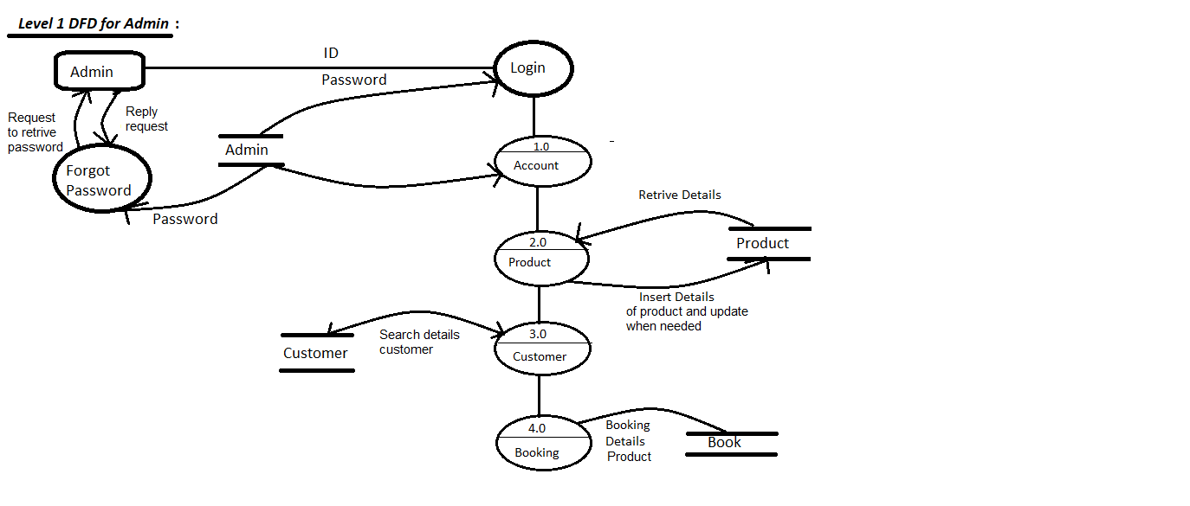
Data Flow Diagram For Admin

Slide 23
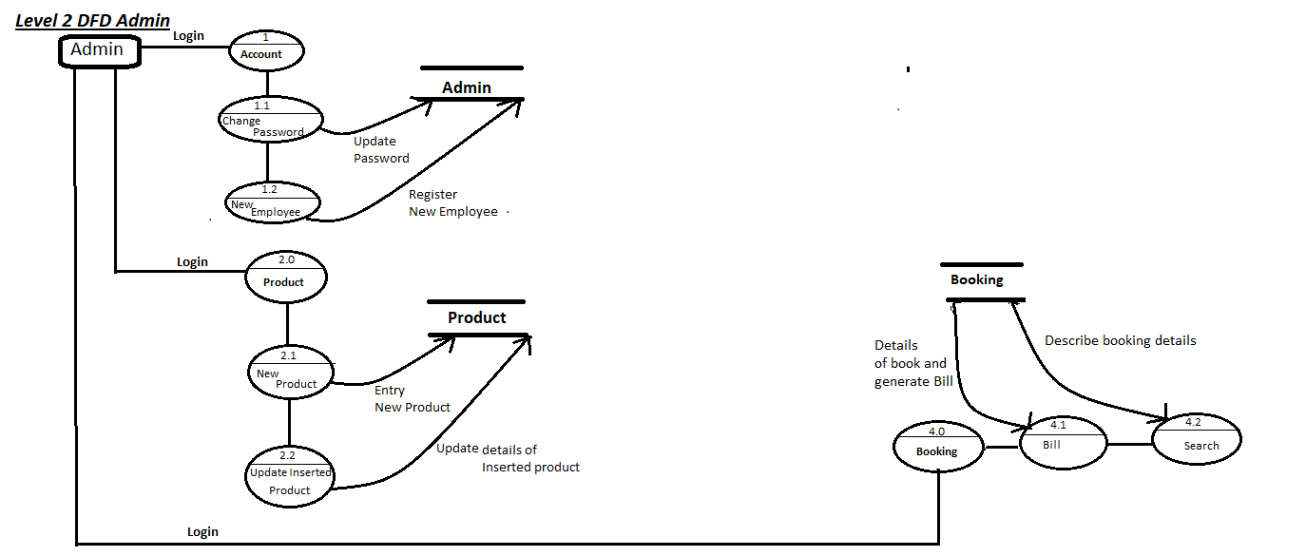
Data Flow Diagram For Admin

Slide 24
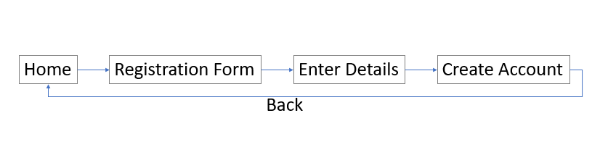
Data Flow Diagram For Account Creation

Slide 25
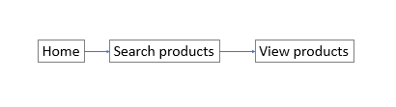
Data Flow Diagram For Product Search

Slide 26
Implement
In this part we create the database and give some input on it to make sure that our system is perfectly ok. So we show some screenshot here.
Page No: 23

Slide 27
Languages used
◆ PHP is a scripting language originally designed for producing dynamic web pages.
◆ HTML which stands for Hypertext Mark up Language, is the predominant mark up language for web pages.
◆ CSS(Cascading Style Sheet) is a style sheet language used to describe the presentation of a document written in a mark up language.
Page No: 30

Slide 28
Testing
After giving all input we should to check that is our system work perfectly or not.
Here is some screen-shot of our system.
Page No: 31

Slide 29
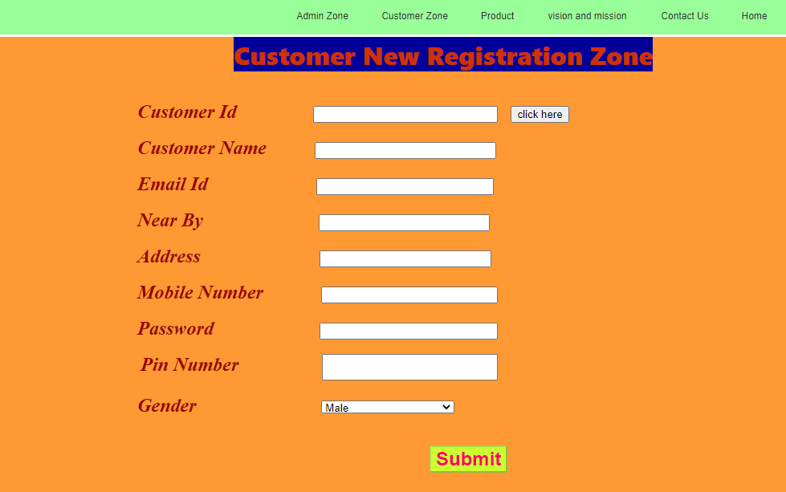
User Registration/Signup page

Slide 30
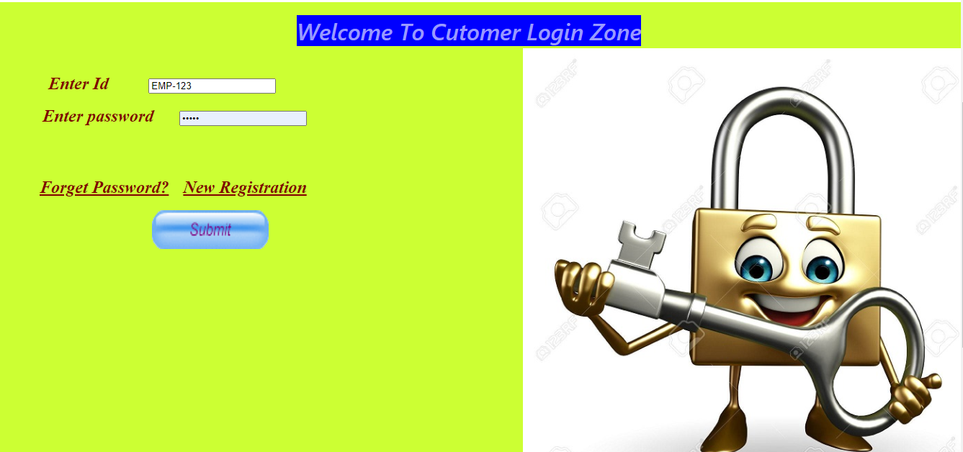
User Login page

Slide 31
Result & Discussion
In this phase, the system is tested. Here is the screen shot of the result.
Page No: 41

Slide 32
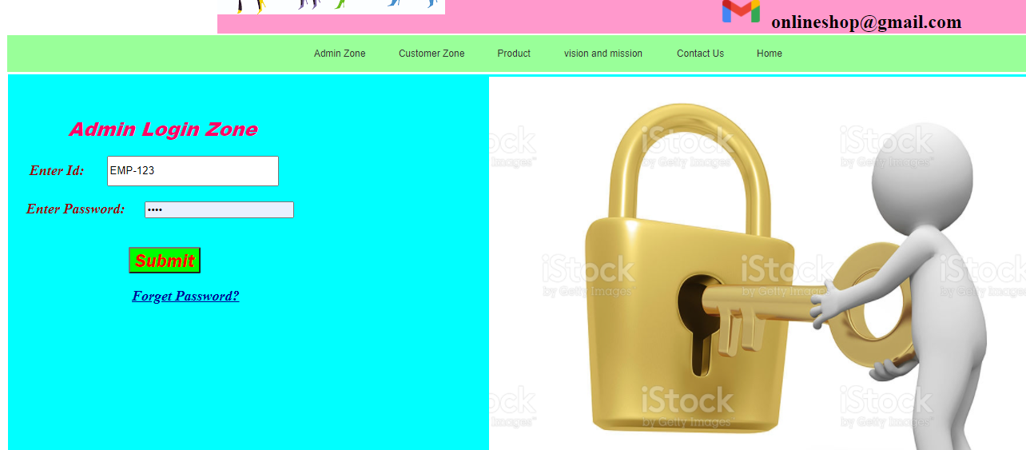
Admin Login page

Slide 33
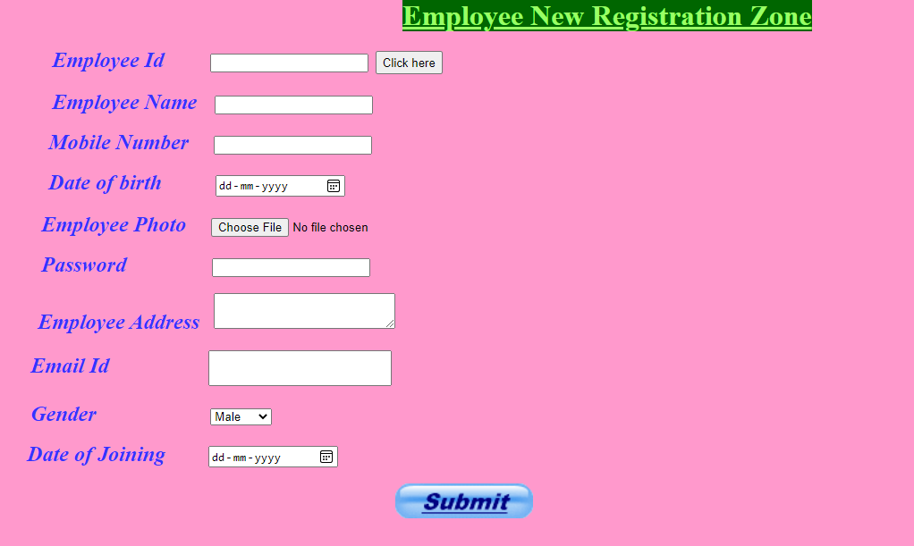
Admin signup page

Slide 34
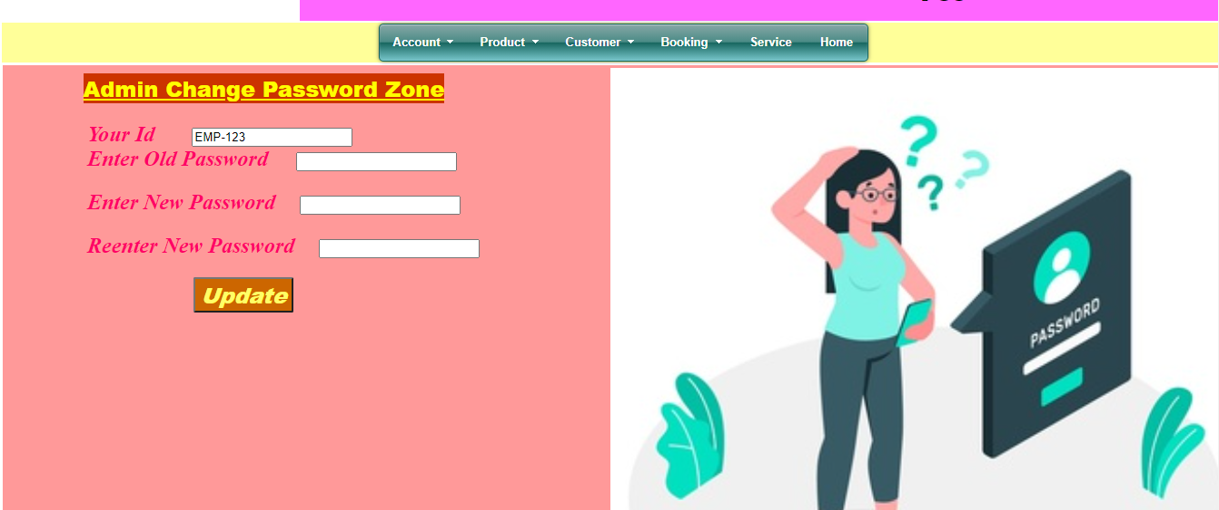
Admin change password page

Slide 35
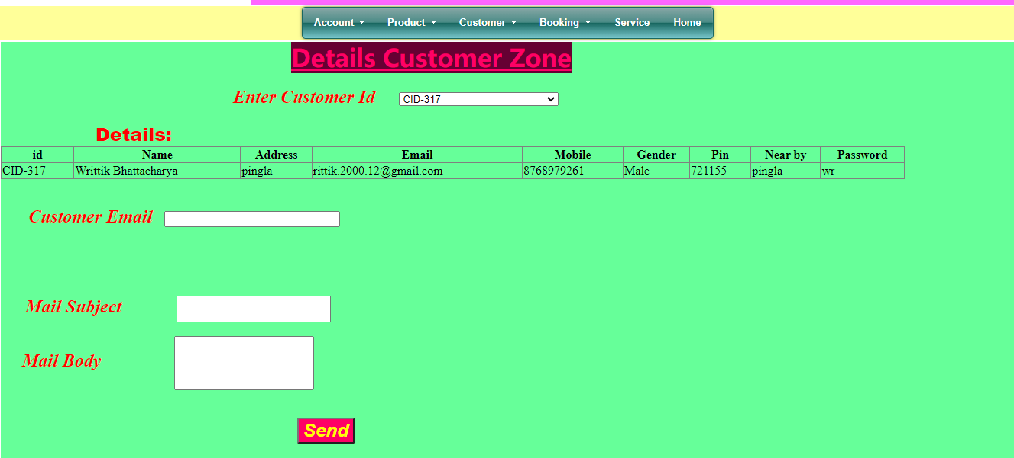
customer details page

Slide 36
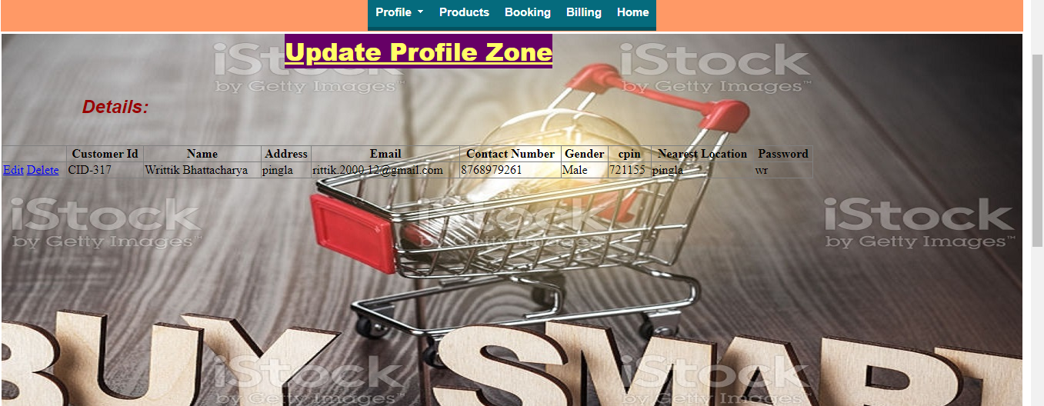
update profile page

Slide 37
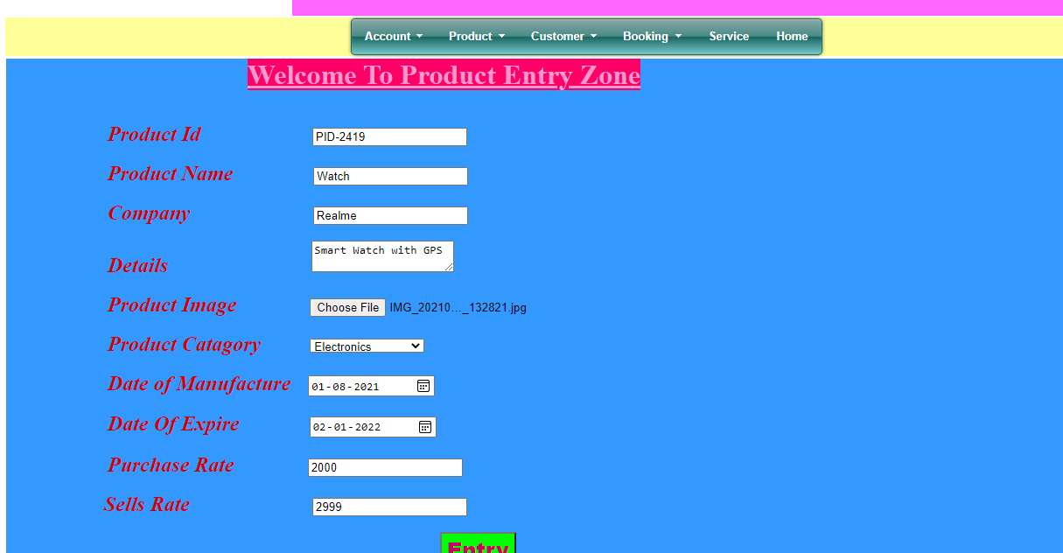
Product entry page

Slide 38
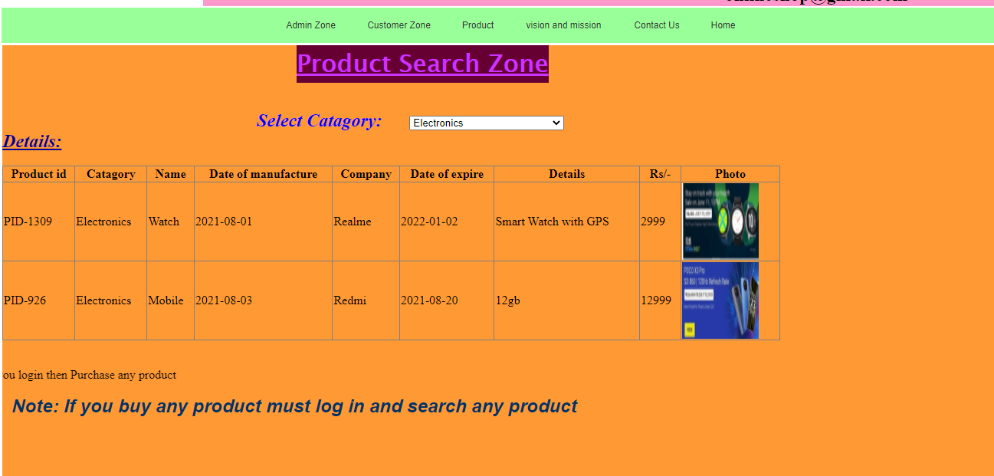
Product search page

Slide 39
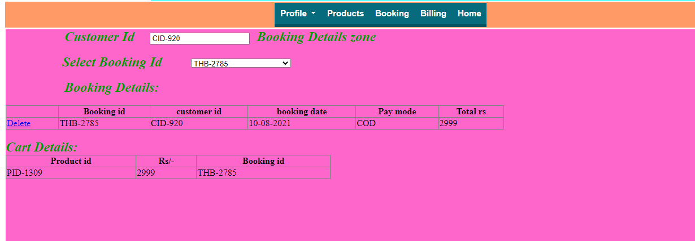
Product book page

Slide 40
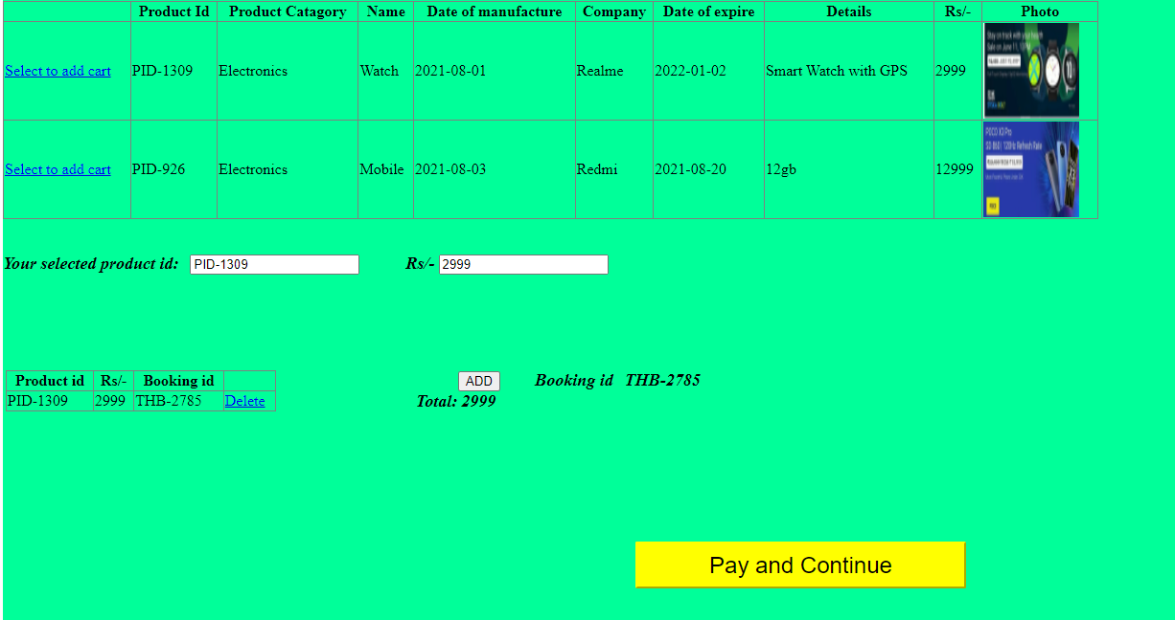
Add to cart page

Slide 41
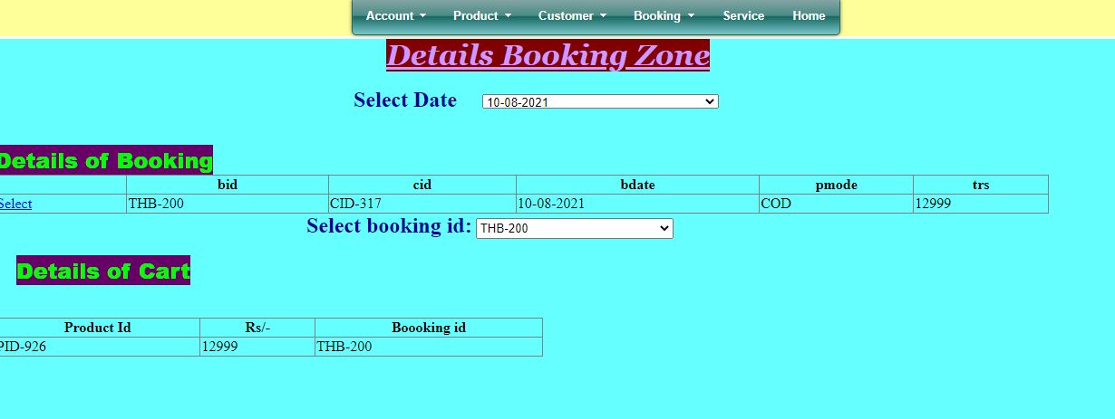
Details booking page

Slide 42
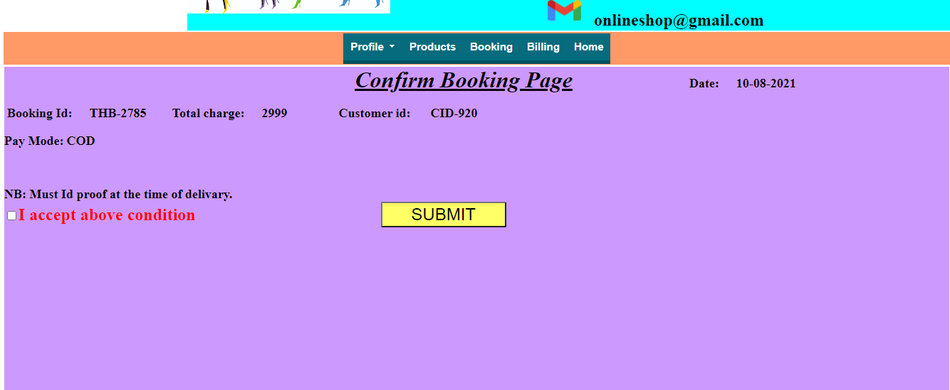
Confirm booking page

Slide 43
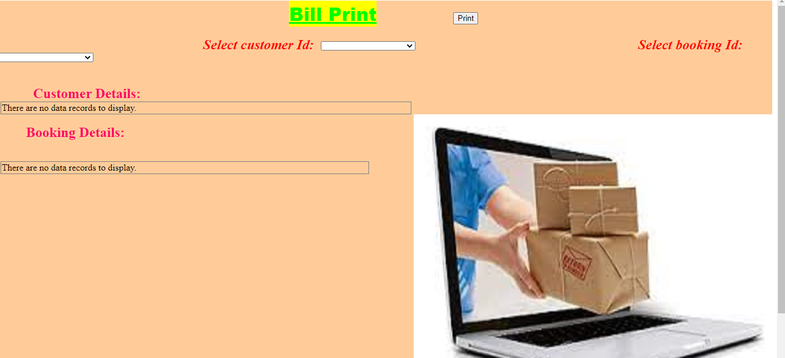
Bill print page

Slide 44
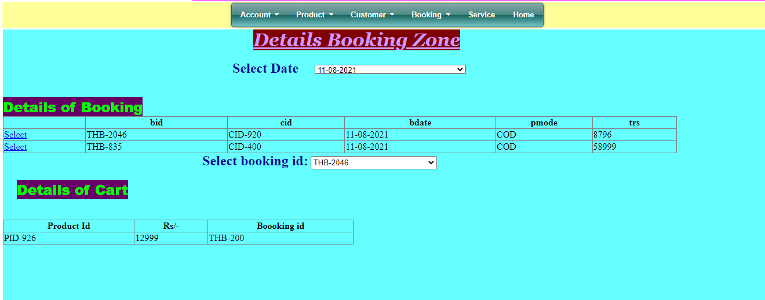
Admin Manage all Order

Slide 45
Limitations
◆ In this application search is limited to string or by number. Cannot do search by photo and finger print.
◆ A typical virus can wash out all information stored in the computer. Then retrieval restoration of data becomes necessary.
◆ Many necessary features are not available now for both user and admin.
Page No: 43

Slide 46
Future Plan
We are thinking of some modifications and adding some advanced
new features in out system. Some of them are –
◆ GUI modification (more user friendly).
◆ Users can signup / login using their social media account such as facebook.
◆ Add more feature in admin panel.
◆ Users can sell their products.
Page No: 44

Slide 47

Conclusion
Online shopping is the best way to purchase any item but be careful because there may be some fake products on different sites.
Only purchase those items which can be recognized easily that item is fake or not or choose according rating of buyers.
But not to worry, on my site you will get all items genuine and trusty, just check once here before buy anywhere.
ONLINE SHOPPING .COM
SPEND FOR QUALITY
Page No: 45

Slide 48
Any Question
???

Slide 49


